Slide 1
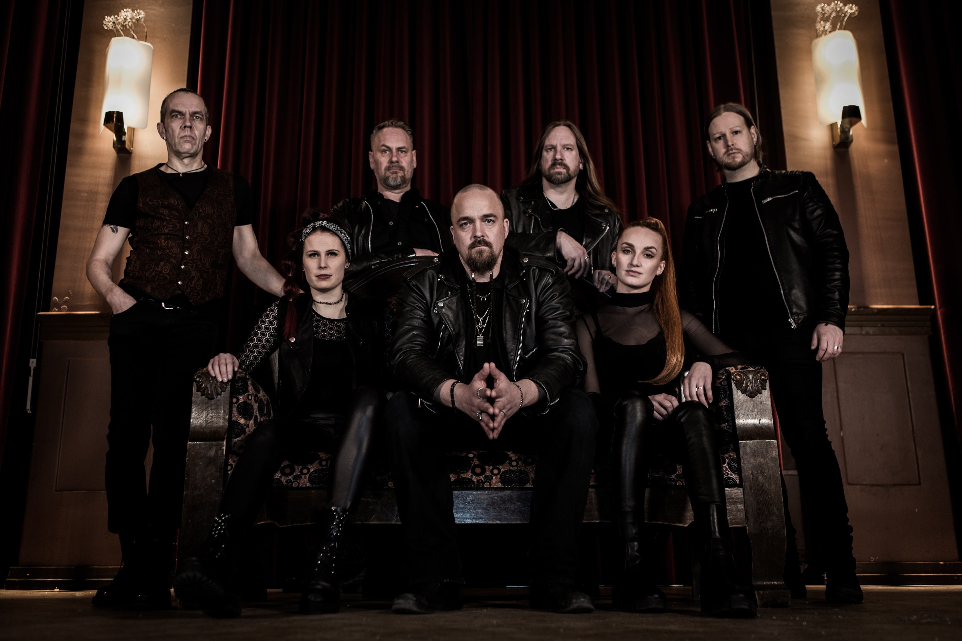




Members:
Vocals – Tommi Niemi
Guitar – Lauri Kovero
Guitar – Raino Ketola
Violin – Henriina Marin
Keyboard – Linda Kuoppala
Drums – Tommi Tanhuanpää
Bass – Jarno Forsman
Melancholic, bit progressive, slightly symphonic, Naryan’s rock is to wake up strong emotions. It narrates stories of sadness, anger, fear or hope... but anyway it stirs up something from deep within.
www.naryanband.com
naryan@naryanband.com
+358 440 627 926 (+358 440 NARYAN)
Info

Slide 2
Download
A Place Where Even Angels Lose Faith
Watch
Room of Angel
The World Is Filled With Silence
Listen
Until We Meet Again in Tidal
History in Spotify
Song links

Slide 3
Naryan's music is lyrical, solemn, sometimes introverted and gloomy, melodic and touching [..] Give it a try and let the feelings and emotions sink in!"
- Dprp.com
"A delightful album of beautiful well-considered melodic music which would grace the music collection of any Progressive Rock aficionado or indeed any music lover."
- House of prog
“This album is one I suspect will end up high on your list of best albums to be released in 2020."
- Progressor
On press

Slide 4

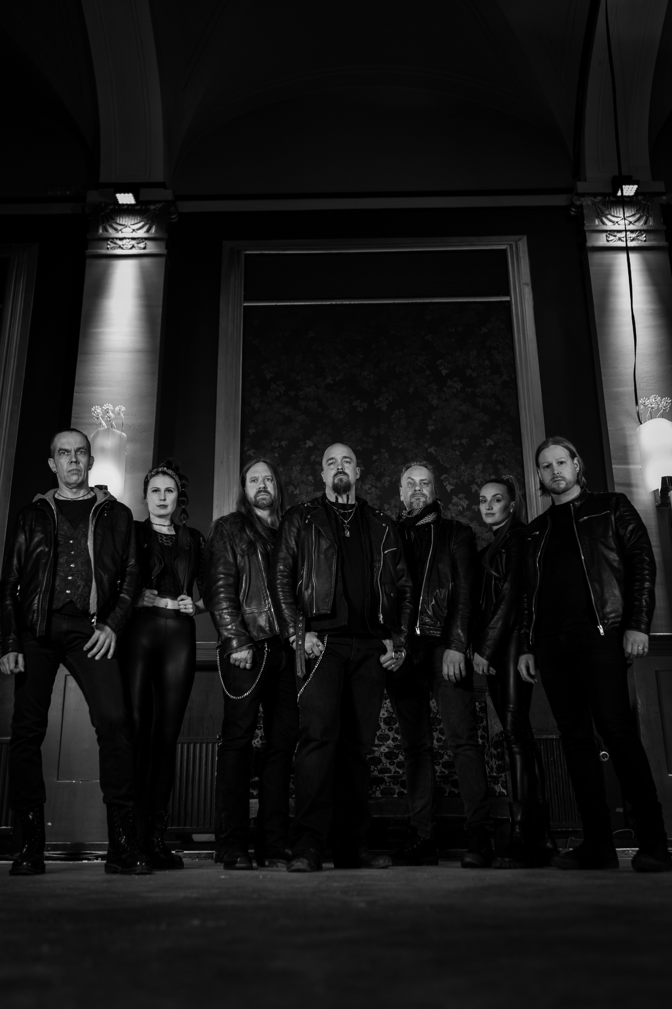


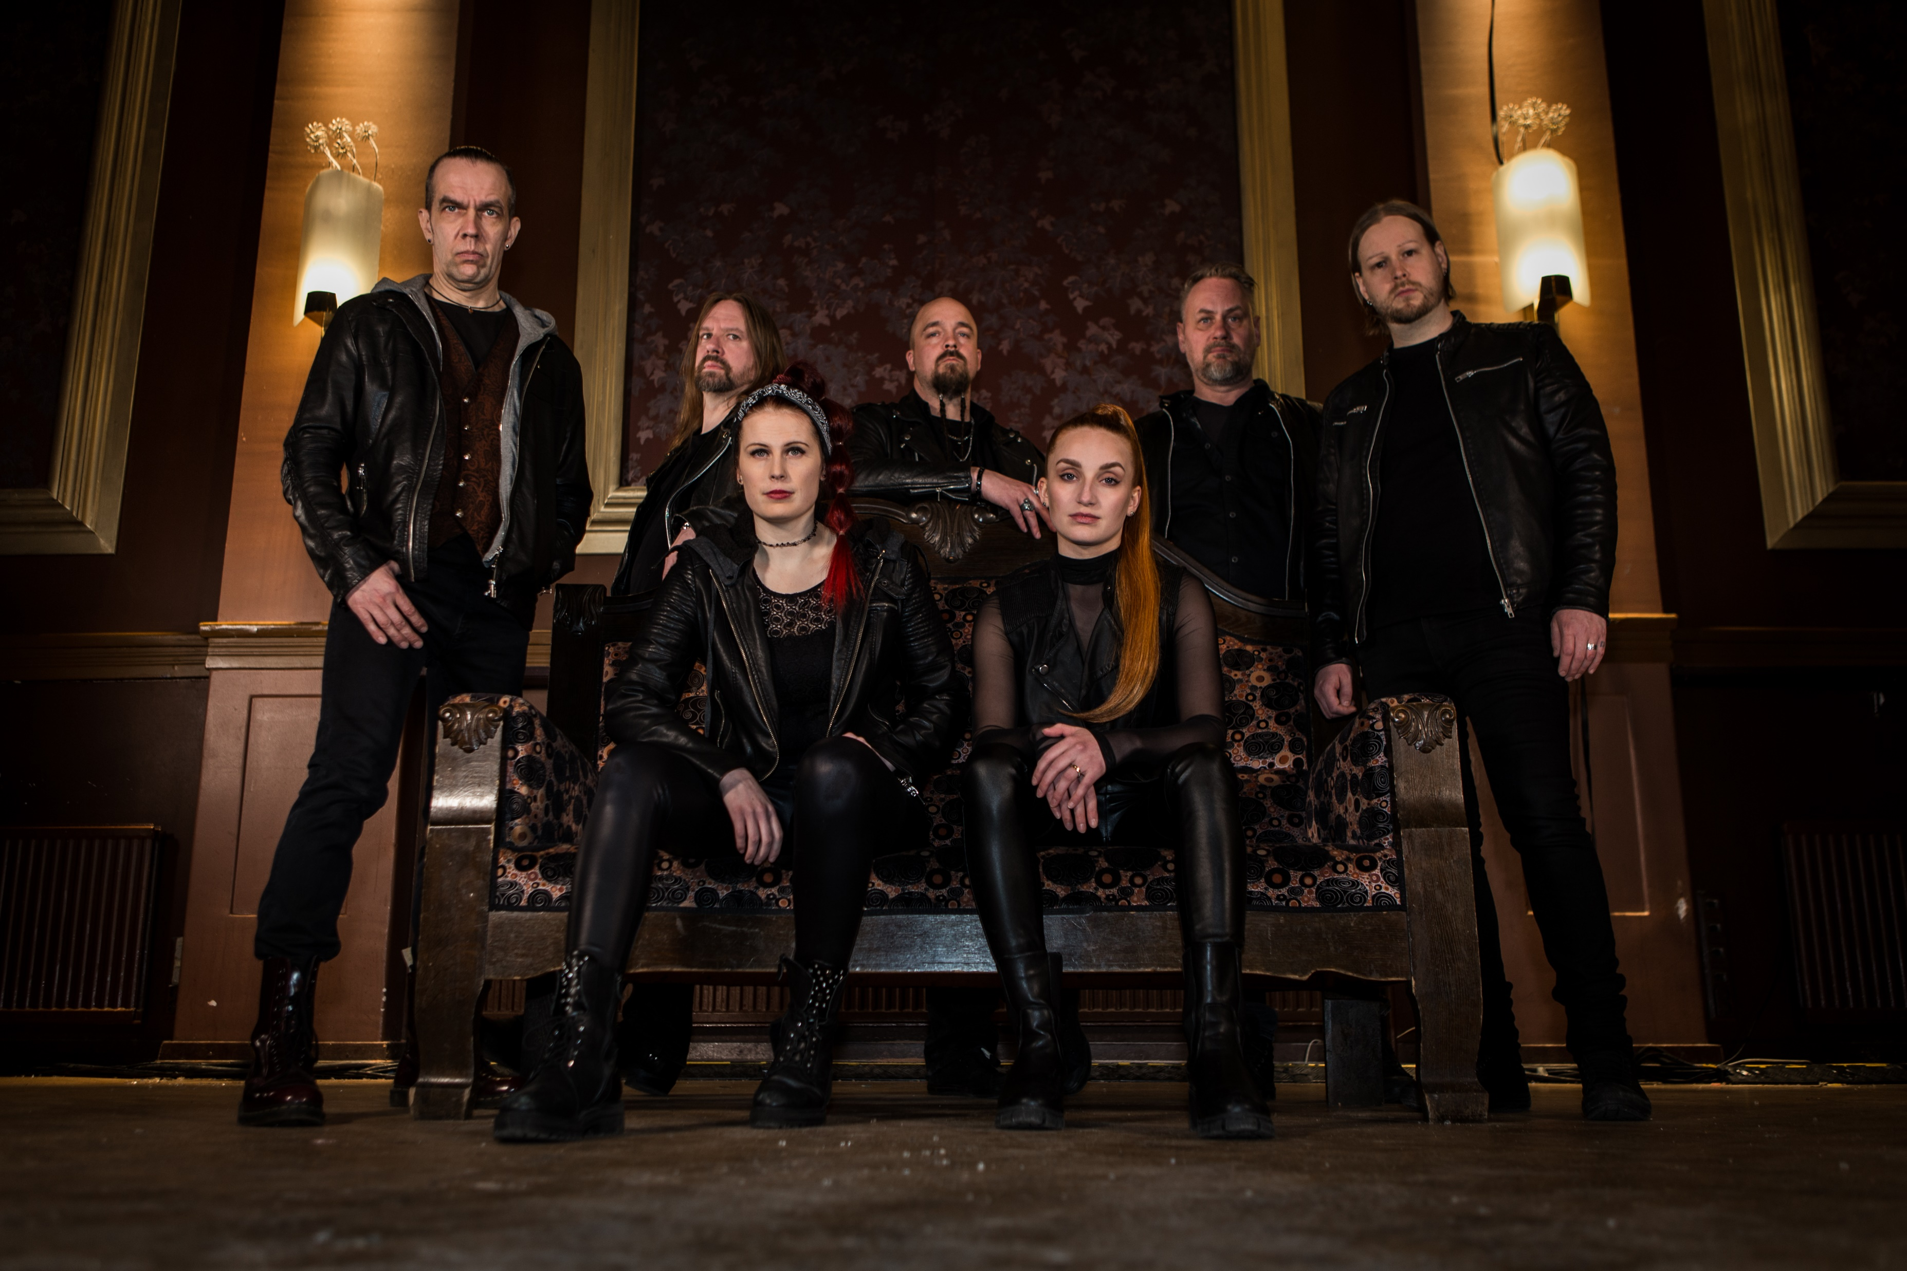
Photo & logo
PHOTOS BY JARI TIMONEN 2023

Slide 5
Drums
Bass
Amp
Backing vocals
Guitar 1
Engl screamer
Guitar 2
Johnson Marquis JM60
In-ear XLR
Need to be miked
(or xlr/jack from pod xl)
Need to be miked
DI-box may be needed
In-ear / XLR
In-ear / XLR
DI-box
Keyboard
Nord stage 3
XLR from DI-box
Violin
In-ear / XLR
Singer
In-ear / XLR
Technical rider
Click –> only monitor
Backing-track -> monitor & mix
Monitor speaker
for singer

Slide 6
 | To mixer | Note | From mixer
Singer | Mic |  | Monitor speaker
Guitarist 1 | Engl Screamer guitar combo | to be miked | In-ear monitor
 | 12-string acoustic guitar | DI-box
Guitarist 2 | Johnson Marquis JM60 guitar combo & POD XT LIVE | to be miked (or directly from POD) | In-ear monitor
Bassist | Some basic bass amp | DI-box
Drummer | Basic drum setup: bd, snare, 1 floor tom, 2 other toms + cymbals |  | In-ear monitor
 | Backing vocals
Violinist | Acoustic violin with attached mic | from DI-box | In-ear monitor
Keyboard | Nord stage 3 | DI-box | In-ear monitor
+ Backing track & click | RCA, jack or XLR | Click to monitor, backing track to PA. Multiple ways possible to produce… should be discussed.
Channels

Slide 7
We have our own monitor mixing system and we are more than willing to use it. Each instrument and backing track is going through Presonus Studiolive 24R mixer. Studiolive gives personalized monitor mixed to each other member except singer. Signal to PA system is taken from Studiolive outputs.
Monitor system

